Slide 1

Comparative Analysis of
Stock Price Prediction
Jonghyun Yoo, Jay Suekang Chae

Slide 2
Table of Contents
Statement of Problem
Stock Price Data
Research Questions & Hypotheses
Machine Learning Models & Hyperparameter Tuning
Results
Research Contribution

Slide 3
1. Statement of Problem
Predict future stock price is challenging task.
With historical stock price dataset, predict stock price using different machine learning models we have learned from CSCE 478/878 class.
Linear Regression
Logistic Regression
Artificial Neural Network
Compare 3 prediction results.
Page 1

Slide 4
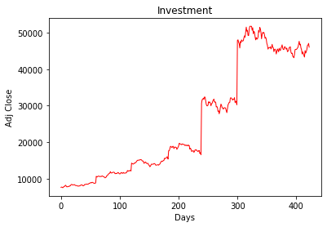

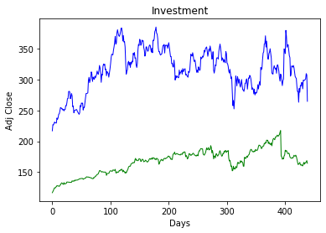


2. Stock Price Data
Samsung, Tesla, Facebook
From: Yahoo Finance
Period: Jan 1st, 2017 ~ Sep 30th, 2018 (637 days)
424 samples for Samsung (unit: ₩)
439 samples for Tesla & Facebook (unit: $)
Data Frame: Open, High, Low, Close, Volume, Adj Close*
Features: Open, High, Low, Close, Volume
Target: Adj Close
Adj Close*: closing price after adjustments for all applicable splits and dividend distributions
Page 2

Slide 5
3. Research Questions & Hypotheses
Research Questions
Which method is going to show best prediction of future stock price?
Hypothesis
Artificial Neural Network model will have best accuracy of stock price prediction, because the stock market data is easily affected by volatile and chaotic characteristics of stock market factors.
Page 3

Slide 6
4. Models & Hyperparameter Tuning
Linear Regression
Logistic Regression
GridSearchCV
Artificial Neural Network
GridSearchCV
Page 4

Slide 7
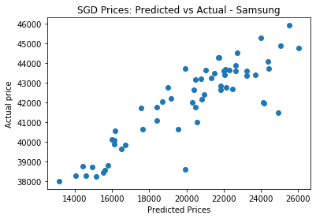
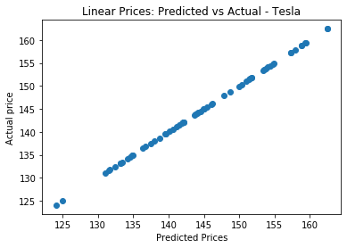
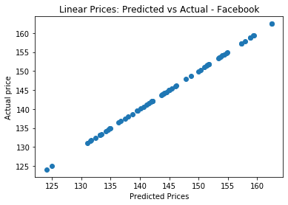
5. Results
RMSE - Samsung
RMSE - Tesla
RMSE - Facebook
Page 5

Slide 8
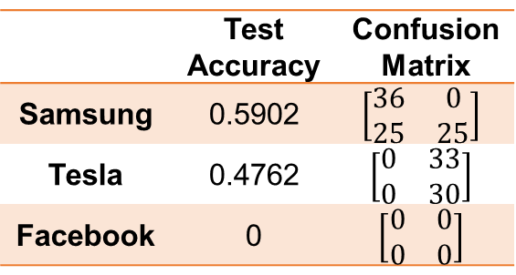
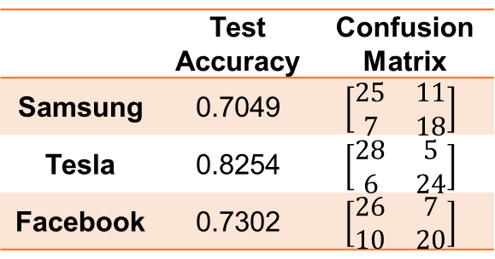
5. Results (con’t)
Evaluation of
Logistic Regression
Evaluation of ANN
 | Test Accuracy | Confusion Matrix
Samsung | 0.7049 | $$\left[\begin{matrix}25 & 11 \\ 7 & 18\end{matrix}\right]$$
Tesla | 0.8254 | $$\left[\begin{matrix}28 & 5 \\ 6 & 24\end{matrix}\right]$$
Facebook | 0.7302 | $$\left[\begin{matrix}26 & 7 \\ 10 & 20\end{matrix}\right]$$
 | Test Accuracy | Confusion Matrix
Samsung | 0.5902 | $$\left[\begin{matrix}36 & 0 \\ 25 & 25\end{matrix}\right]$$
Tesla | 0.4762 | $$\left[\begin{matrix}0 & 33 \\ 0 & 30\end{matrix}\right]$$
Facebook | 0 | $$\left[\begin{matrix}0 & 0 \\ 0 & 0\end{matrix}\right]$$
6. Research Contribution
Acquire Machine Learning Skills (Linear, Logistic, ANN)
Page 6

Slide 9

Thank you Questions?

